Slide 1
A List Implementation that Links Data
Chapter 14
Data Structures and Abstractions with Java, 4e
Frank Carrano
© 2015 Pearson Education, Inc., Upper Saddle River, NJ. All rights reserved.

Slide 2
Advantages of
Linked Implementation
Uses memory only as needed
When entry removed, unneeded memory returned to system
Avoids moving data when adding or removing entries
© 2015 Pearson Education, Inc., Upper Saddle River, NJ. All rights reserved.

Slide 3
Adding a Node at Various Positions
Possible cases:
Chain is empty
Adding node at chain’s beginning
Adding node between adjacent nodes
Adding node to chain’s end
© 2015 Pearson Education, Inc., Upper Saddle River, NJ. All rights reserved.

Slide 4

Adding a Node
This pseudocode establishes a new node for the given data
© 2015 Pearson Education, Inc., Upper Saddle River, NJ. All rights reserved.

Slide 5
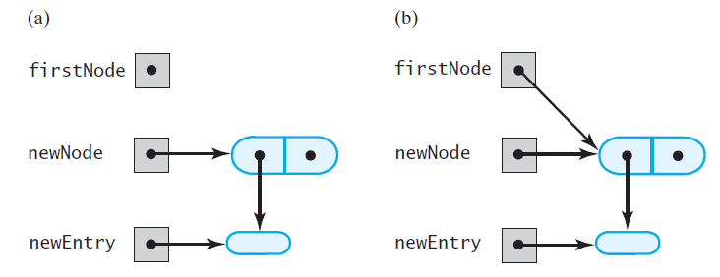
Adding a Node
FIGURE 14-1 (a) An empty chain and a new node; (b) after adding the new node to a chain that was empty
© 2015 Pearson Education, Inc., Upper Saddle River, NJ. All rights reserved.

Slide 6
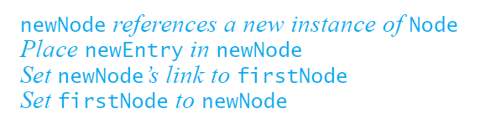
Adding a Node
This pseudocode describes the steps needed to
add a node to the beginning of a chain.
© 2015 Pearson Education, Inc., Upper Saddle River, NJ. All rights reserved.

Slide 7
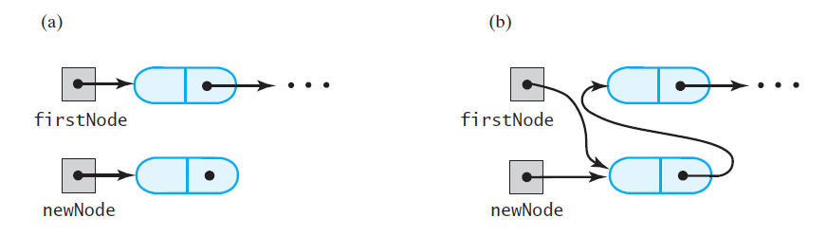
Adding a Node
FIGURE 14-2 A chain of nodes (a) just prior to adding a node at the beginning; (b) just after adding a node at the beginning
© 2015 Pearson Education, Inc., Upper Saddle River, NJ. All rights reserved.

Slide 8
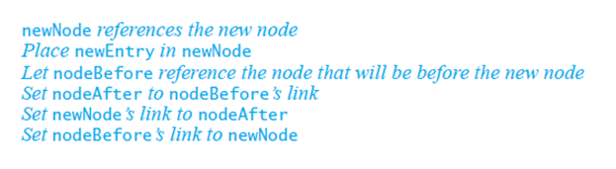
Adding a Node
Pseudocode to add a node to a chain between
two existing, consecutive nodes
© 2015 Pearson Education, Inc., Upper Saddle River, NJ. All rights reserved.

Slide 9
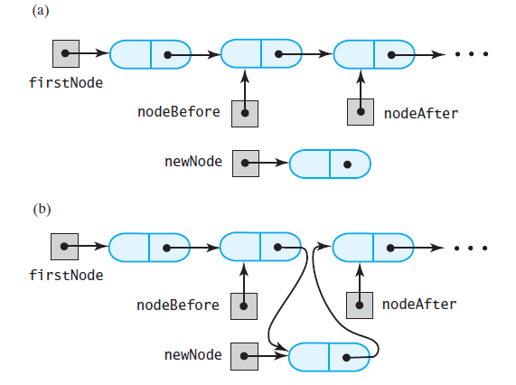
Adding a Node
FIGURE 14-3 A chain of nodes (a) just prior to adding a node between two adjacent nodes; (b) just after adding a node between two adjacent nodes
© 2015 Pearson Education, Inc., Upper Saddle River, NJ. All rights reserved.

Slide 10
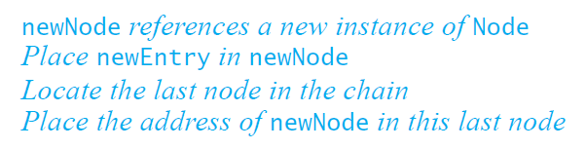
Adding a Node
Steps to add a node at the end of a chain.
© 2015 Pearson Education, Inc., Upper Saddle River, NJ. All rights reserved.

Slide 11
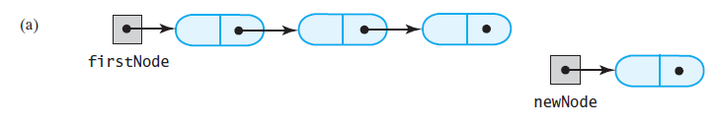
Adding a Node
FIGURE 14-4 A chain of nodes
(a) prior to adding a node at the end
© 2015 Pearson Education, Inc., Upper Saddle River, NJ. All rights reserved.

Slide 12
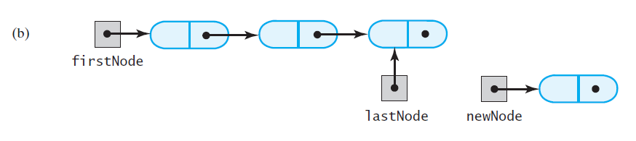
Adding a Node
FIGURE 14-4 A chain of nodes
(b) after locating its last node;
© 2015 Pearson Education, Inc., Upper Saddle River, NJ. All rights reserved.

Slide 13
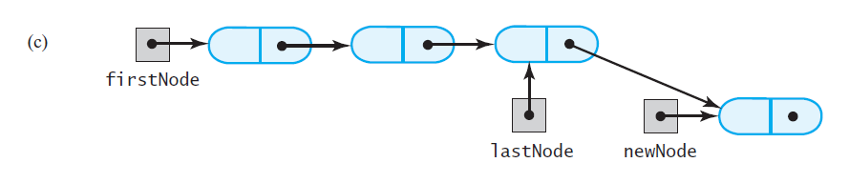
Adding a Node
FIGURE 14-4 A chain of nodes
(c) after adding a node at the end
© 2015 Pearson Education, Inc., Upper Saddle River, NJ. All rights reserved.

Slide 14
Removing a Node from Various Positions
Possible cases
Removing the first node
Removing a node other than first one
© 2015 Pearson Education, Inc., Upper Saddle River, NJ. All rights reserved.

Slide 15
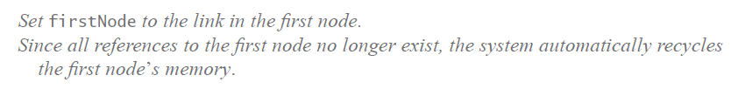
Removing a Node
Steps for removing the first node.
© 2015 Pearson Education, Inc., Upper Saddle River, NJ. All rights reserved.

Slide 16
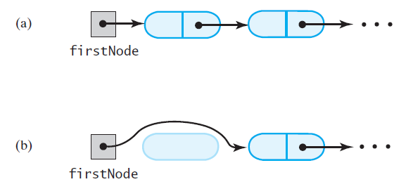
Removing a Node
FIGURE 14-5 A chain of nodes (a) just prior to removing the first node; (b) just after removing the first node
© 2015 Pearson Education, Inc., Upper Saddle River, NJ. All rights reserved.

Slide 17
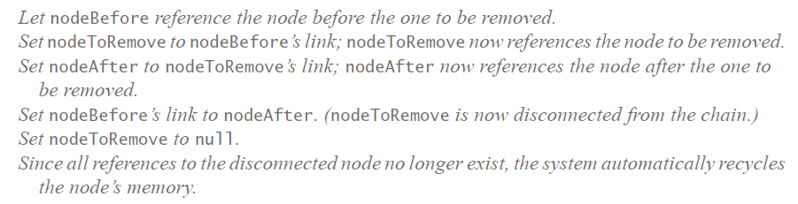
Removing a Node
Removing a node other than the first one.
© 2015 Pearson Education, Inc., Upper Saddle River, NJ. All rights reserved.

Slide 18
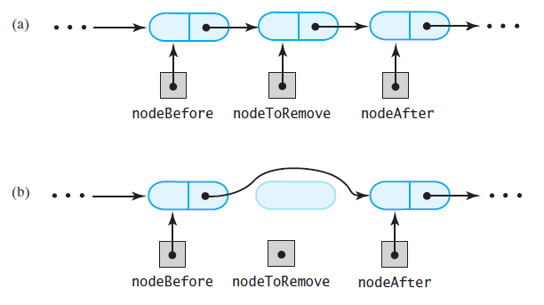
Removing a Node
FIGURE 14-6 A chain of nodes (a) just prior to removing an interior node; (b) just after removing an interior node
© 2015 Pearson Education, Inc., Upper Saddle River, NJ. All rights reserved.

Slide 19
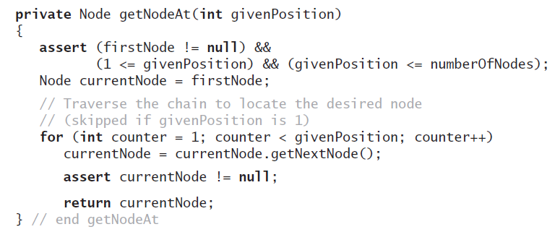
Removing a Node
Operations on a chain depended
on the method getNodeAt
© 2015 Pearson Education, Inc., Upper Saddle River, NJ. All rights reserved.

Slide 20
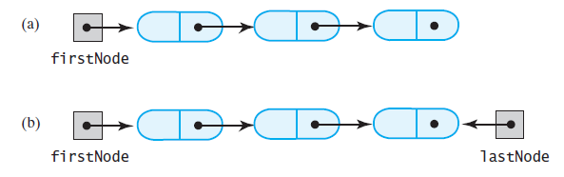
Design Decision
A Link to Last Node
FIGURE 14-7 A linked chain with (a) a head reference;
(b) both a head reference and a tail reference
© 2015 Pearson Education, Inc., Upper Saddle River, NJ. All rights reserved.

Slide 21
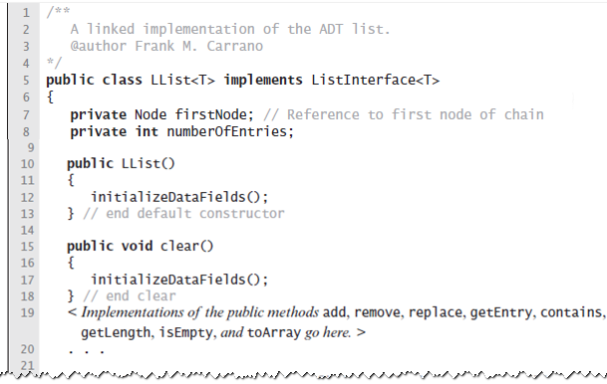
Data Fields and Constructor
LISTING 14-1 An outline of the class LList
© 2015 Pearson Education, Inc., Upper Saddle River, NJ. All rights reserved.

Slide 22
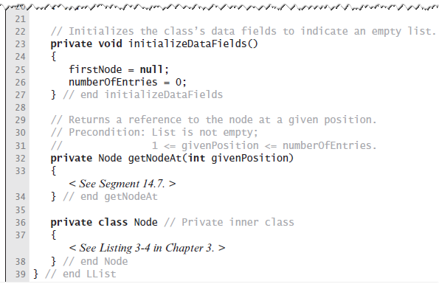
Data Fields and Constructor
LISTING 14-1 An outline of the class LList
© 2015 Pearson Education, Inc., Upper Saddle River, NJ. All rights reserved.

Slide 23
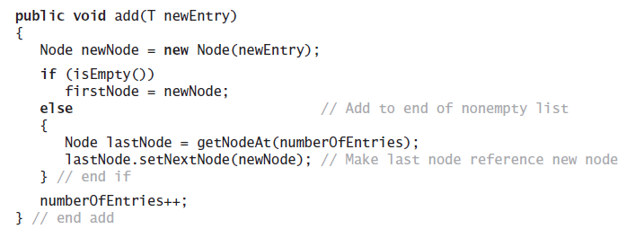
Adding to the End of the List
The method add assumes method getNodeAt
© 2015 Pearson Education, Inc., Upper Saddle River, NJ. All rights reserved.

Slide 24
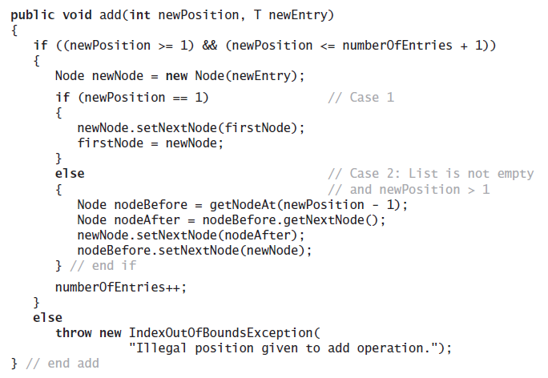
Adding at a Given Position
Java method.
© 2015 Pearson Education, Inc., Upper Saddle River, NJ. All rights reserved.

Slide 25
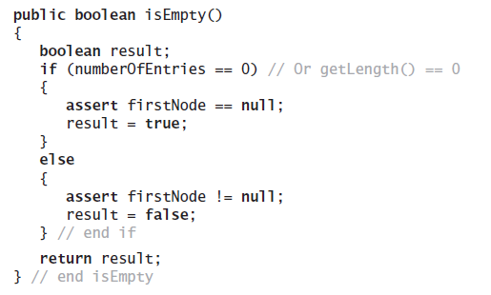
Method isEmpty
Note use of assert statement.
© 2015 Pearson Education, Inc., Upper Saddle River, NJ. All rights reserved.

Slide 26
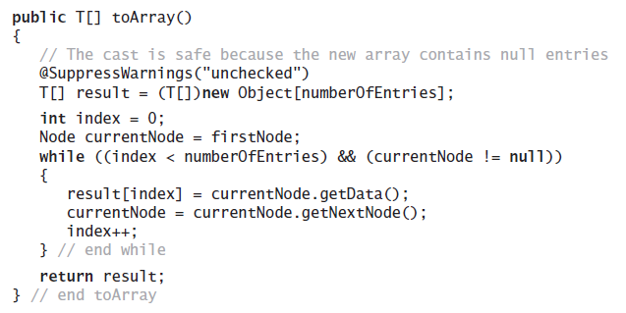
Method toArray
Traverses chain, loads an array.
© 2015 Pearson Education, Inc., Upper Saddle River, NJ. All rights reserved.

Slide 27
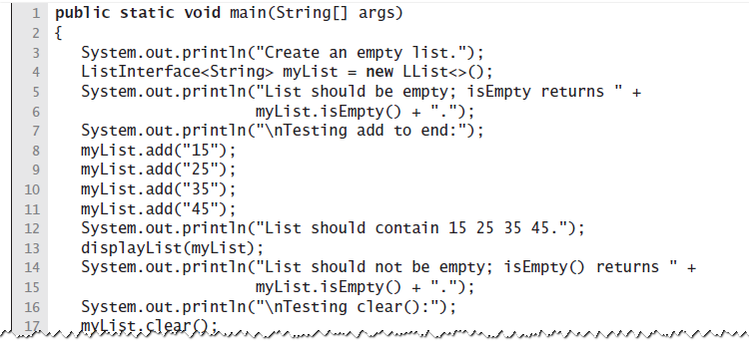
Testing Core Methods
LISTING 14-2 A main method that tests part of the implementation of the ADT list
© 2015 Pearson Education, Inc., Upper Saddle River, NJ. All rights reserved.

Slide 28
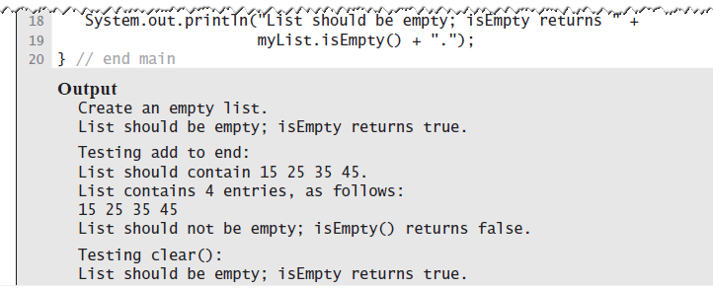
Testing Core Methods
LISTING 14-2 A main method that tests part of the implementation of the ADT list
© 2015 Pearson Education, Inc., Upper Saddle River, NJ. All rights reserved.

Slide 29
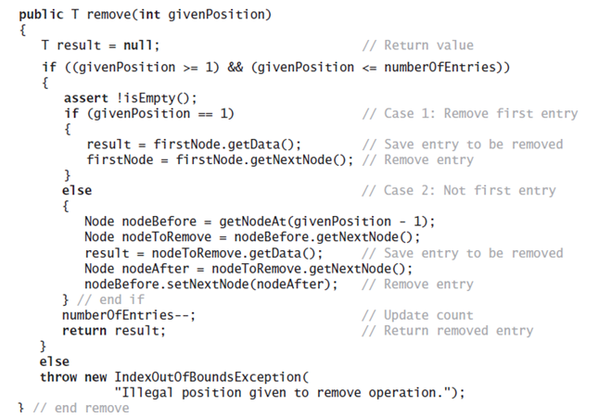
Continuing the Implementation
The remove method returns the entry
that it deletes from the list
© 2015 Pearson Education, Inc., Upper Saddle River, NJ. All rights reserved.

Slide 30
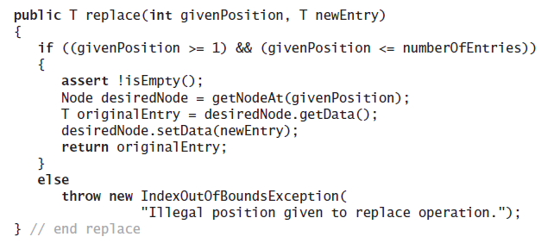
Continuing the Implementation
Replacing a list entry requires us to replace
the data portion of a node with other data.
© 2015 Pearson Education, Inc., Upper Saddle River, NJ. All rights reserved.

Slide 31
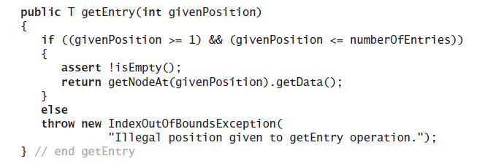
Continuing the Implementation
Retrieving a list entry is straightforward.
© 2015 Pearson Education, Inc., Upper Saddle River, NJ. All rights reserved.

Slide 32
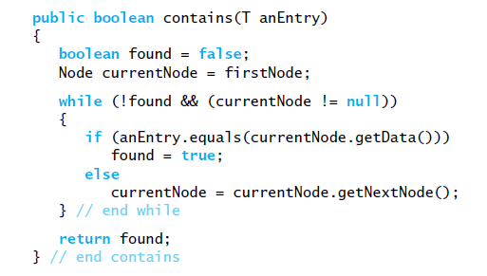
Continuing the Implementation
Checking to see if an entry is in the list,
the method contains.
© 2015 Pearson Education, Inc., Upper Saddle River, NJ. All rights reserved.

Slide 33
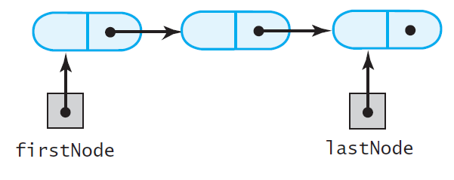
A Refined Implementation
FIGURE 14-8 A linked chain with both a head
reference and a tail reference
© 2015 Pearson Education, Inc., Upper Saddle River, NJ. All rights reserved.

Slide 34
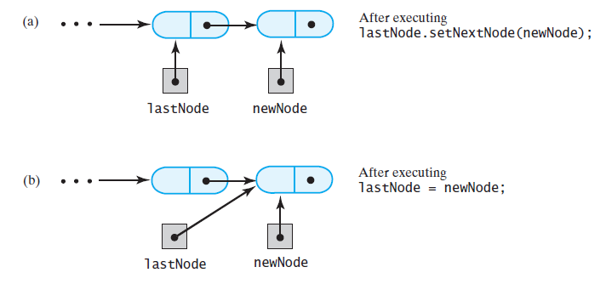
A Refined Implementation
FIGURE 14-9 Adding a node to the end of a
nonempty chain that has a tail reference
© 2015 Pearson Education, Inc., Upper Saddle River, NJ. All rights reserved.

Slide 35
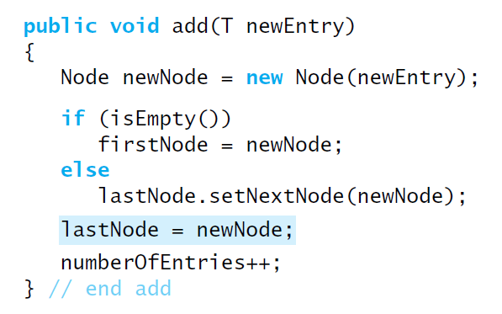
A Refined Implementation
Revision of the first add method
© 2015 Pearson Education, Inc., Upper Saddle River, NJ. All rights reserved.

Slide 36
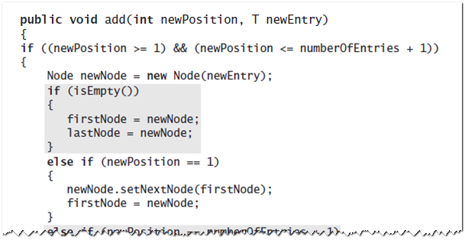
A Refined Implementation
Implementation of the method that adds by position.
© 2015 Pearson Education, Inc., Upper Saddle River, NJ. All rights reserved.

Slide 37
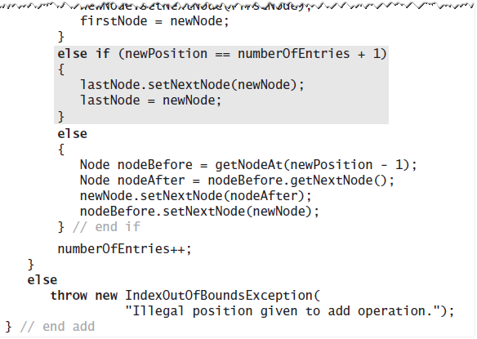
A Refined Implementation
Implementation of the method that adds by position.
© 2015 Pearson Education, Inc., Upper Saddle River, NJ. All rights reserved.

Slide 38
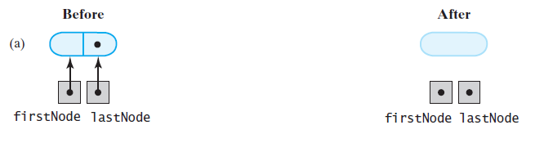
A Refined Implementation
FIGURE 14-10 Removing the last node from a chain that has both head and tail references when
the chain contains (a) one node
© 2015 Pearson Education, Inc., Upper Saddle River, NJ. All rights reserved.

Slide 39
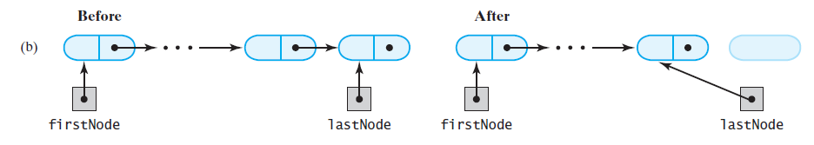
A Refined Implementation
FIGURE 14-10 Removing the last node from a chain that has both head and tail references when the chain contains (b) more than one node
© 2015 Pearson Education, Inc., Upper Saddle River, NJ. All rights reserved.

Slide 40
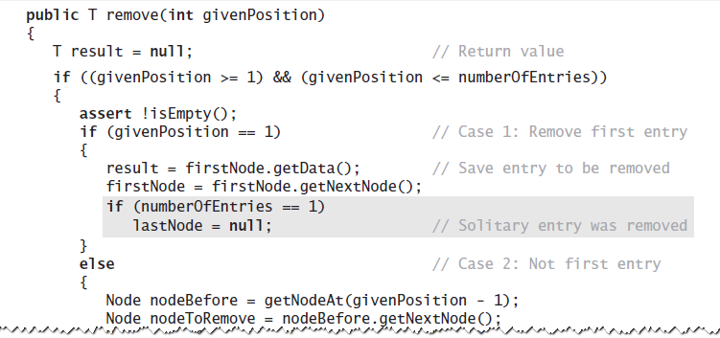
A Refined Implementation
Implementation of the remove operation:
© 2015 Pearson Education, Inc., Upper Saddle River, NJ. All rights reserved.

Slide 41
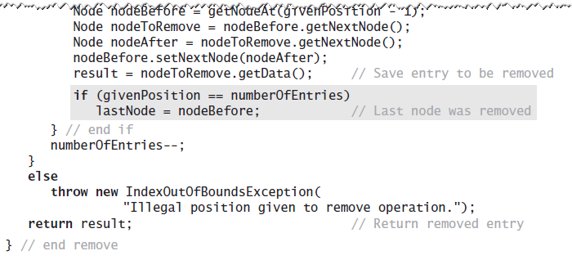
A Refined Implementation
Implementation of the remove operation:
© 2015 Pearson Education, Inc., Upper Saddle River, NJ. All rights reserved.

Slide 42
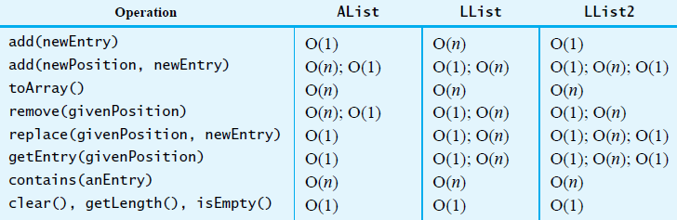
Efficiency of Using a Chain
FIGURE 14-11 The time efficiencies of the ADT list operations for three implementations,
expressed in Big Oh notation
© 2015 Pearson Education, Inc., Upper Saddle River, NJ. All rights reserved.

Slide 43
Java Class Library:
The Class LinkedList
Implements the interface List
LinkedList defines more methods than are in the interface List
You can use the class LinkedList as implementation of ADT
  queue
  deque
  or list.
© 2015 Pearson Education, Inc., Upper Saddle River, NJ. All rights reserved.

Slide 44
End
Chapter 14
© 2015 Pearson Education, Inc., Upper Saddle River, NJ. All rights reserved.

